Slide 1





目前演讲人：PinZhao Li
Olist E-commerce Data Analysis
PinZhao Li , YanYu Liu , GengShang Dong , Vincent William

Slide 2



目前演讲人：PinZhao Li
Background and problem setup

Slide 3




目前演讲人：PinZhao Li
Background and Problem Setup
Olist is a Brazilian startup that operates in the e-commerce segment , mainly through the marketplace. It is well spread within the country.
This project is a detailed analysis on the comprehensive Olist data.
olist_order_customers_dataset - This dataset has information about the customer and its location. Use it to identify unique customers in the orders dataset and to find the orders delivery location.
olist_geolocation_dataset - This dataset has information Brazilian zip codes and its lat/lng coordinates.
olist_order_items_dataset - This dataset includes data about the items purchased within each order.
olist_order_payments_dataset - This dataset includes data about the orders payment options.
olist_order_reviews_dataset - This dataset includes data about the reviews made by the customers.
olist_orders_dataset - This is the core dataset. Every necessary information is mapped to each order in this.
olist_products_dataset - This dataset includes data about the products sold by Olist.
olist_sellers_dataset - This dataset includes data about the sellers that fulfilled orders made at Olist.

Slide 4



目前演讲人：PinZhao Li
Multiple analysis tasks
Ranging from descriptive analysis to forecasting and predictive analysis
Preliminary Data Analysis
Freight Value Prediction
Product Analysis
Association Rule Mining
Reviews Sentiment Analysis

Slide 5



目前演讲人：PinZhao Li
Preliminary Data Analysis
Exploratory analysis
Merging with Brazil Population Data
Geographical distribution of buyers and sellers
Monthly trend

Slide 6

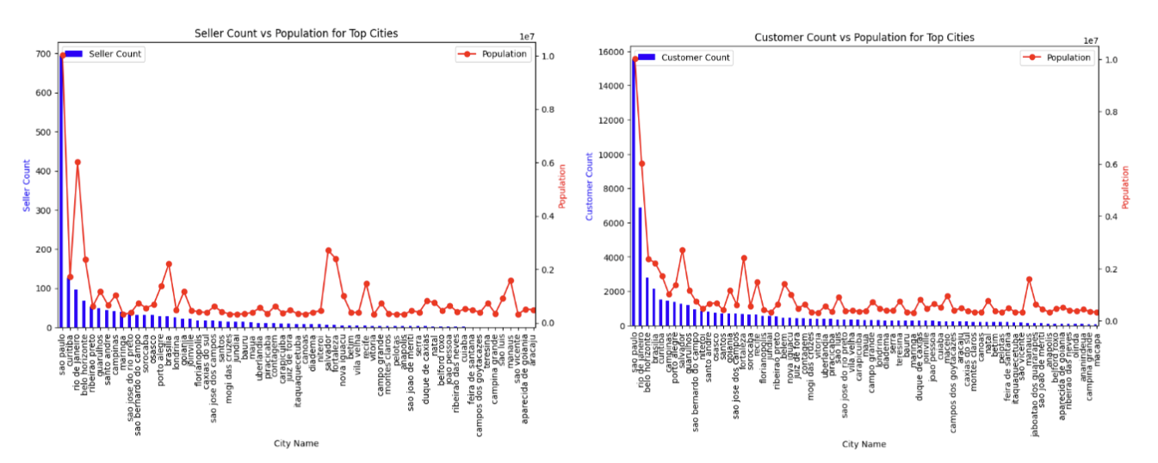
目前演讲人：PinZhao Li
Merging with Brazil Population Data
Brazil Cities Population Data:The current population of Brazil is 215,653,799 as of Friday, July 22, 2022, based on Worldometer elaboration of the latest United Nations data.

Slide 7
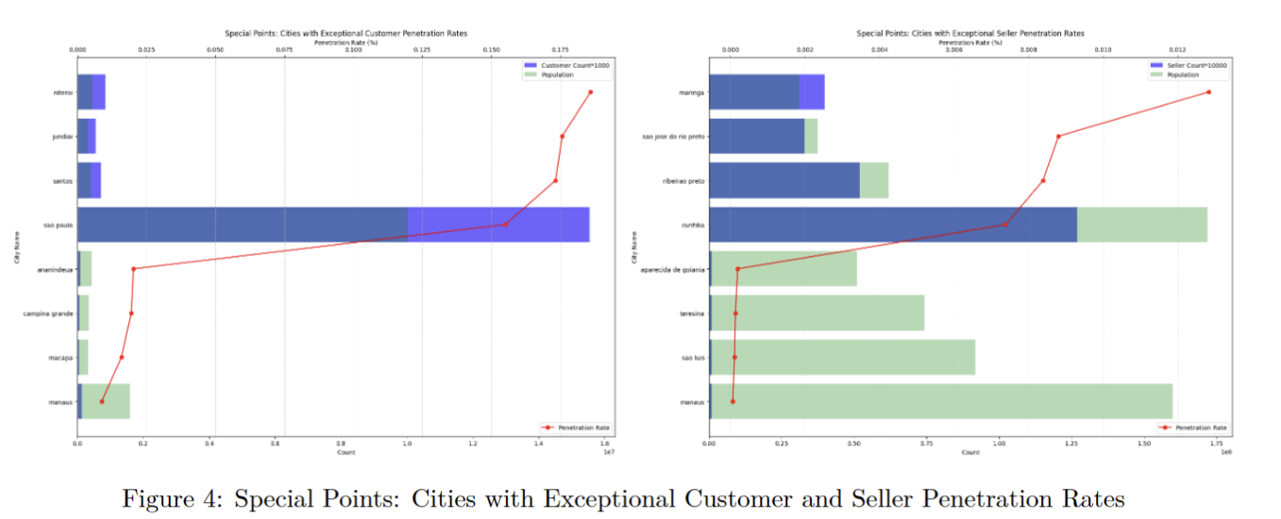
目前演讲人：PinZhao Li
So the concept of Penetration Rate was introduced: customers\population and sellers\population
Notes:
Sao Paulo appears prominently in the customer penetration chart but not in the seller penetration chart, indicating a
higher customer base compared to sellers.
Curitiba shows significant presence in both charts, highlighting its importance in both customer and seller markets.
Cities like Manaus and Macapa have high customer penetration rates but do not appear in the seller penetration chart,
suggesting a customer-centric market.
Conversely, cities like Aparecida de Goiania and Teresina have high seller penetration rates but are not prominent in
the customer penetration chart, indicating a seller-centric marke

Slide 8

Geographical Distribution of Orders

Slide 9
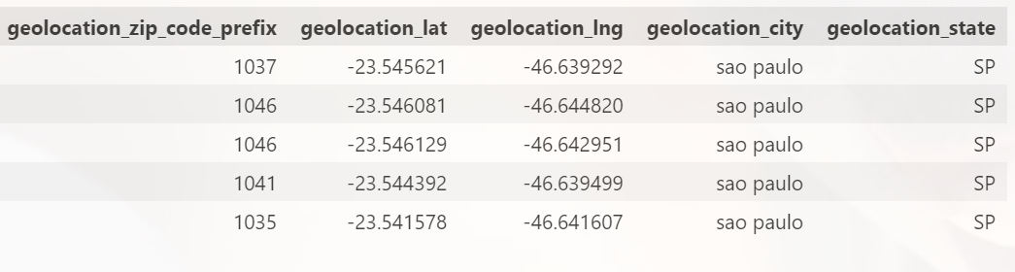
Geolocation Dataset

Slide 10
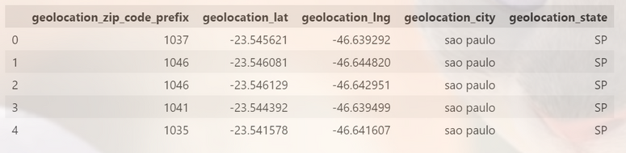
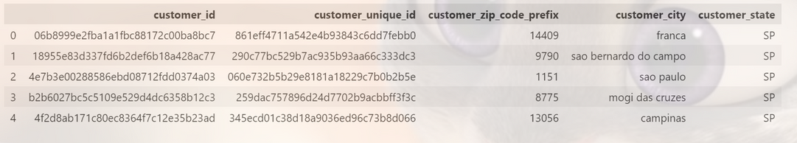
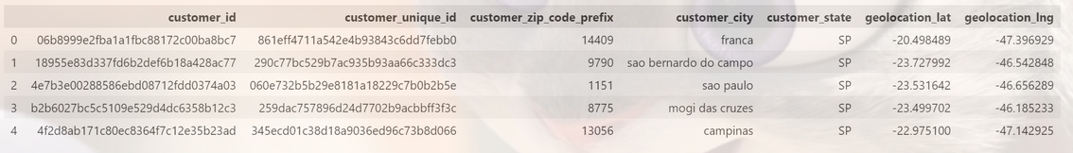


Geolocation Dataset
Customer Dataset
Customer_geolocation

Slide 11
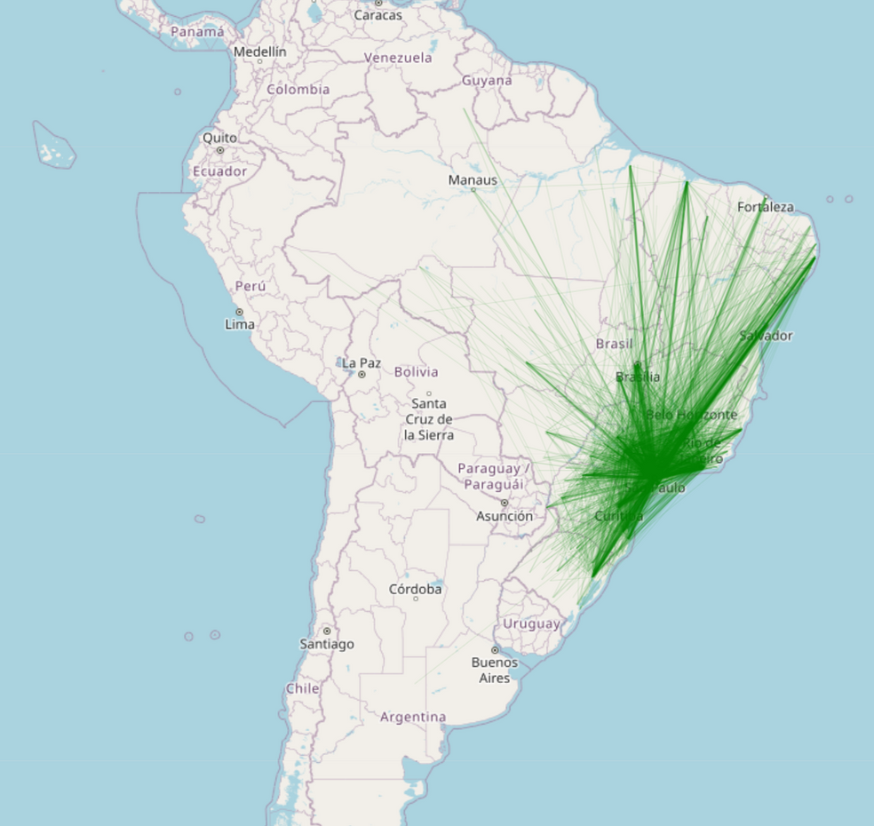
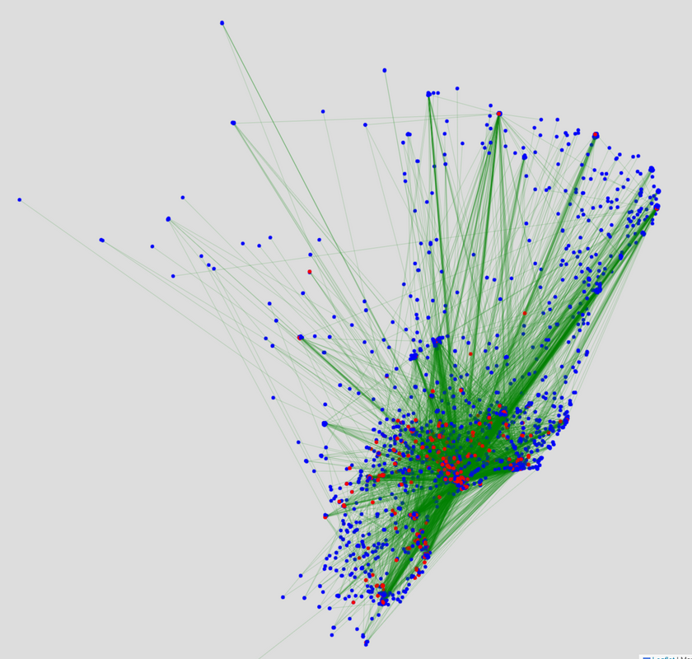
Orders on the map

Slide 12
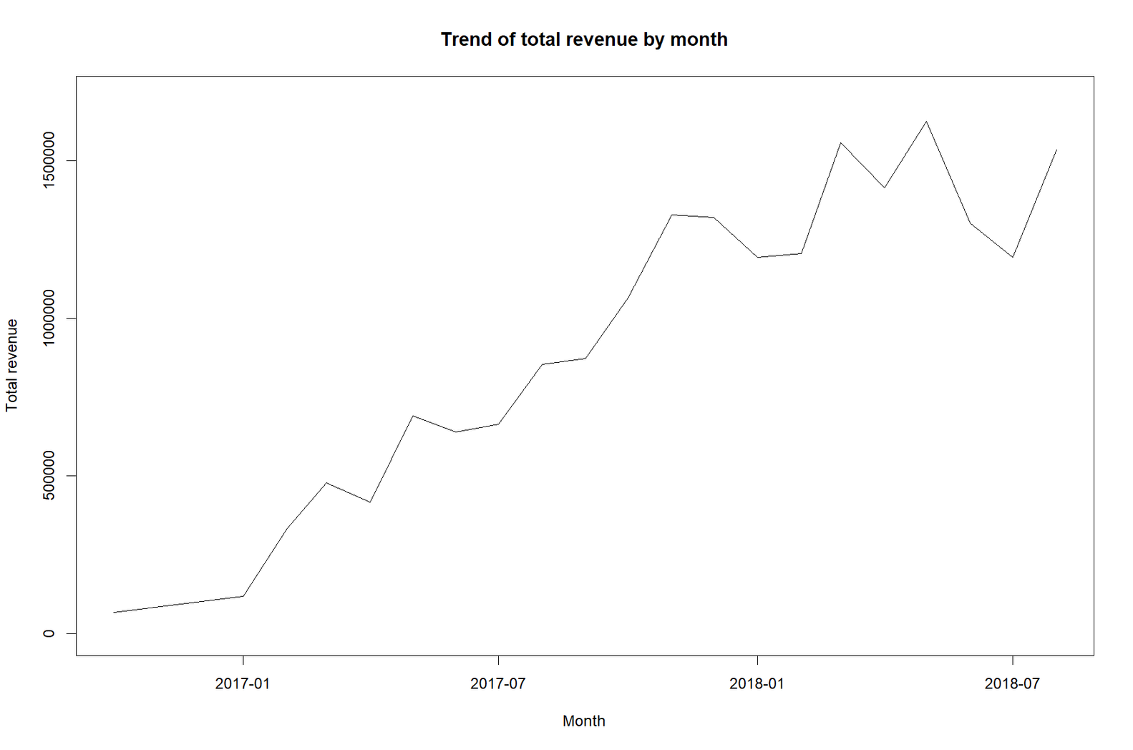

Monthly trend
Vincent William Hadiasali

Slide 13
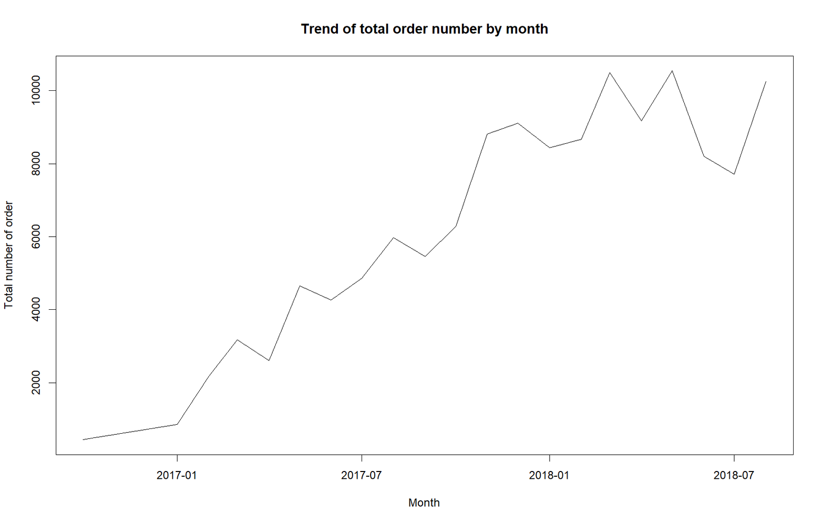
Monthly trend

Slide 14



Freight value prediction
Using time series analysis.
Analysis will include stationary test, autocorrelation test, experimenting around a couple of well-known time series transformation and their forecasts.
Vincent William Hadiasali

Slide 15


Time Series Background Information
Stationarity, autocorrelation, statistics test.

Slide 16
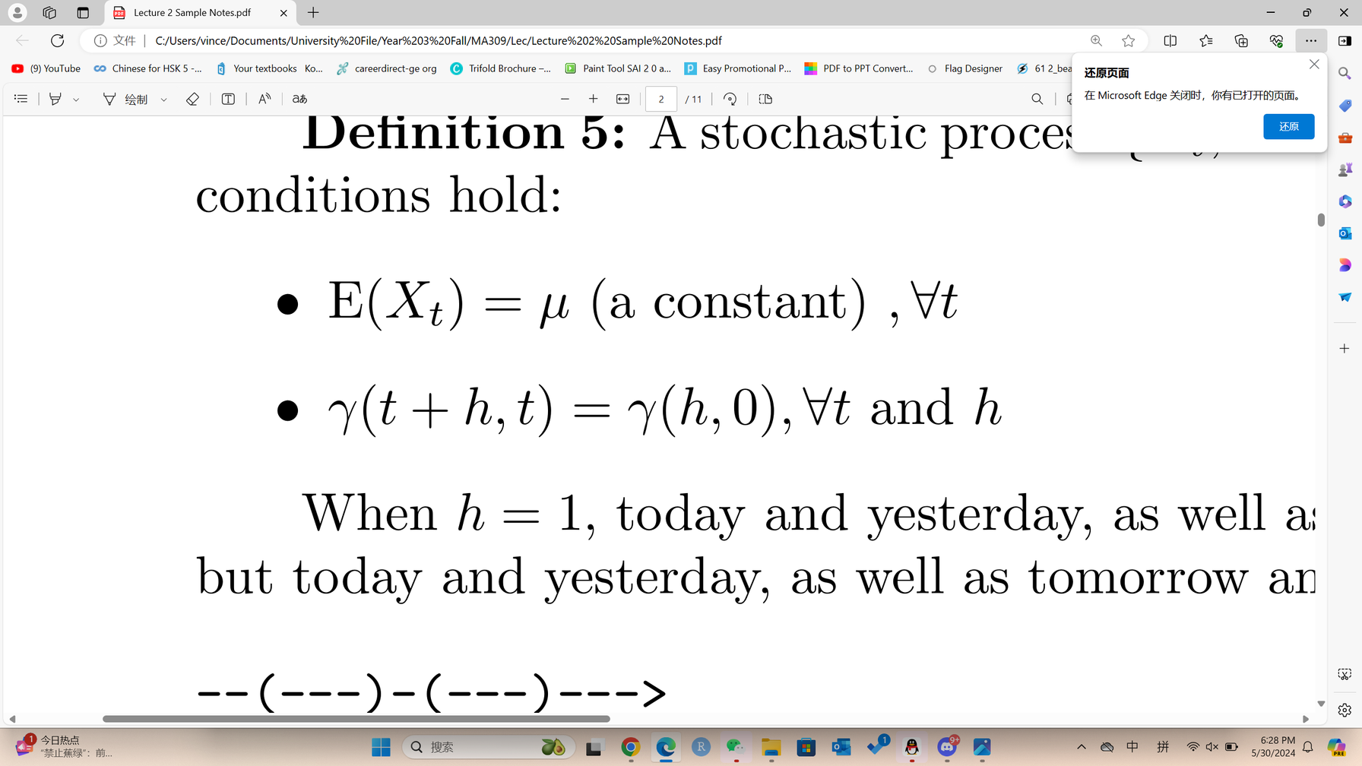
Definition of stationary
A stochastic process {X_t, t = 0,±1,±2,...} is said to be stationary if the following conditions hold:
where γ(t+h, t) = Cov(X_{t+h}, X_t)

Slide 17
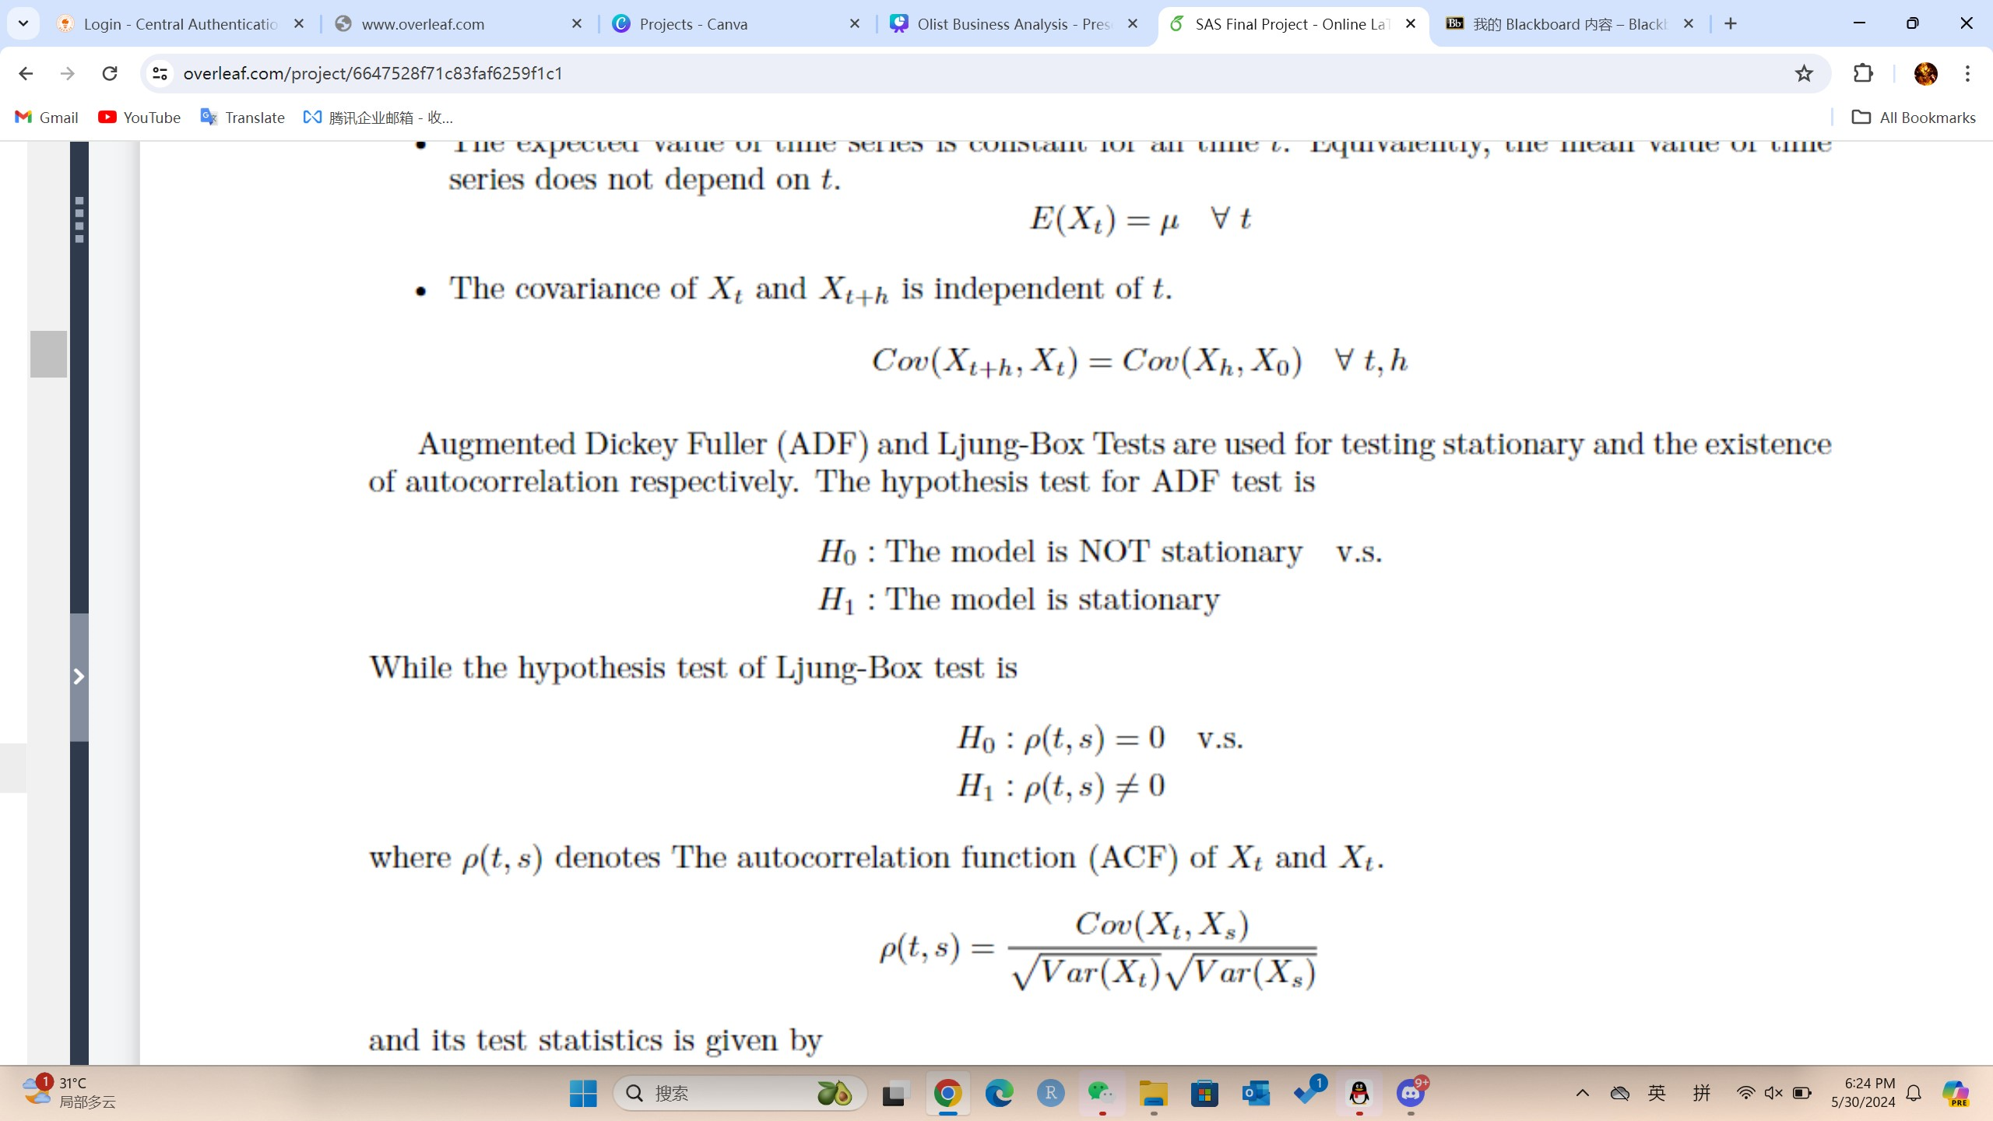

ADF Test:
Testing stationarity
Box-Ljung Test:
Testing autocorrelation

Slide 18

It is test and forecast time!
The best thing to happen

Slide 19
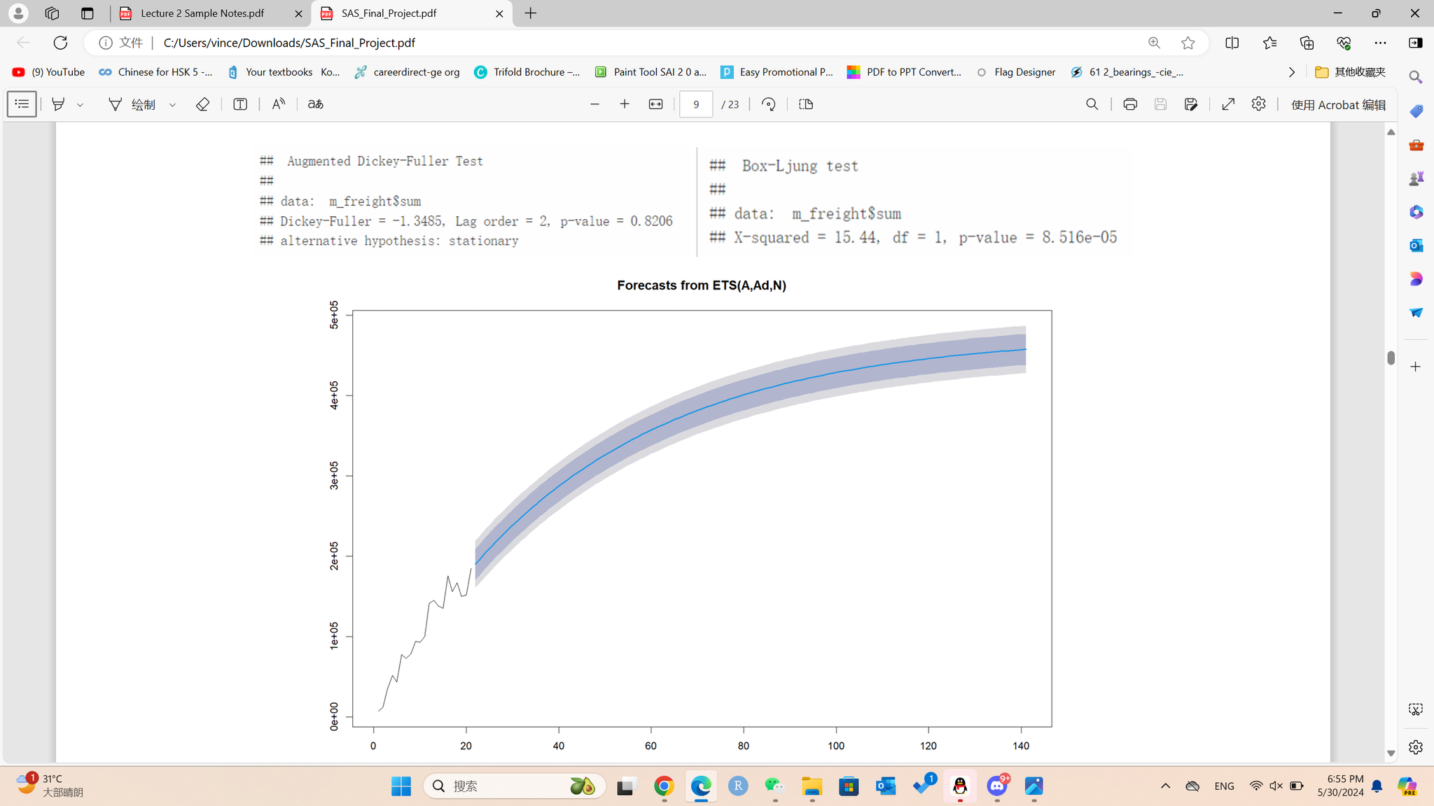
Monthly freight value

Slide 20
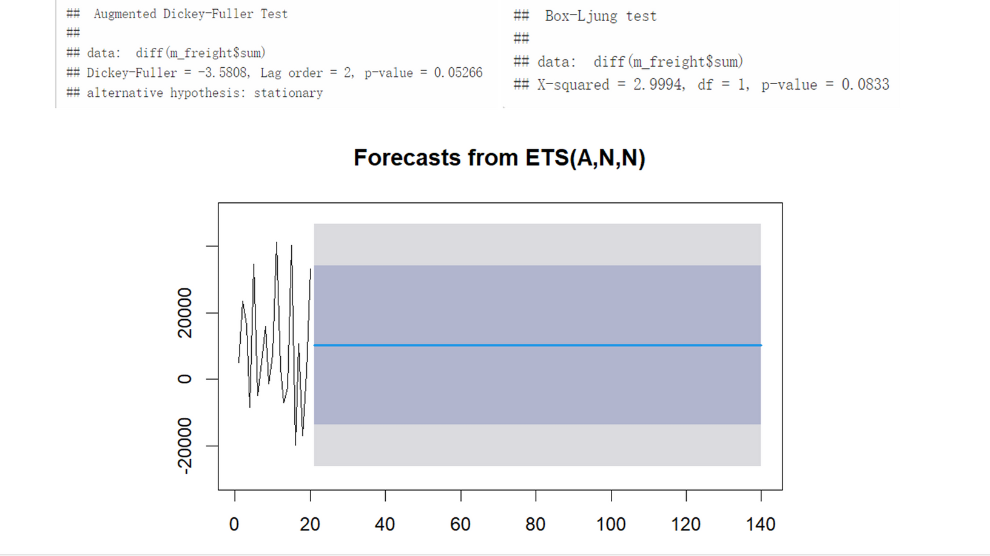
Differenced Monthly freight value

Slide 21
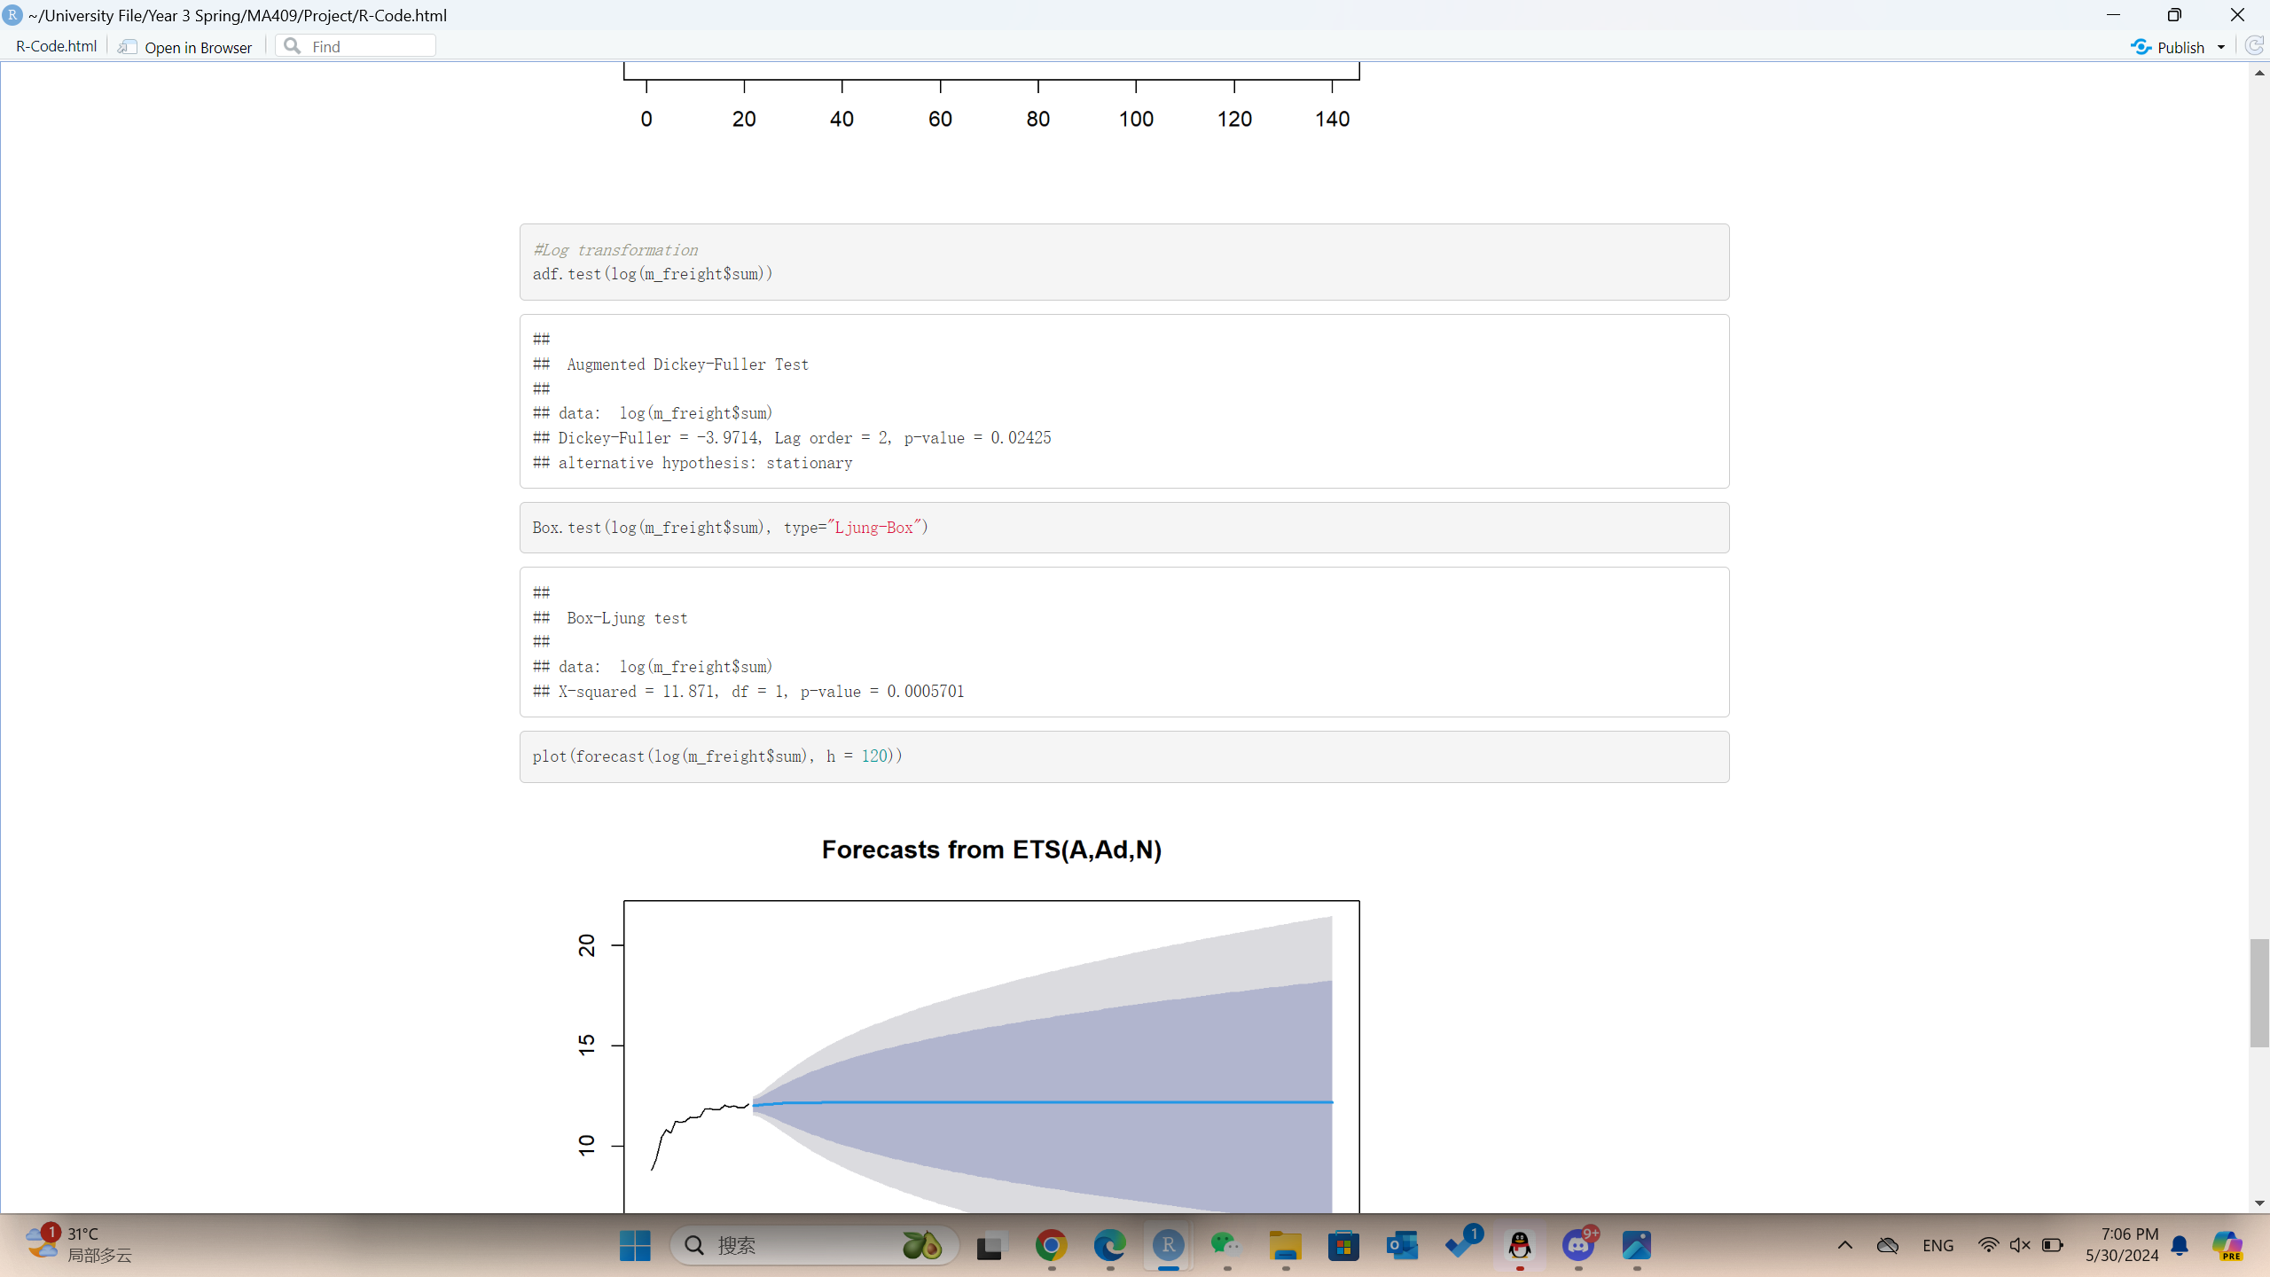
log-transformed Monthly freight value

Slide 22
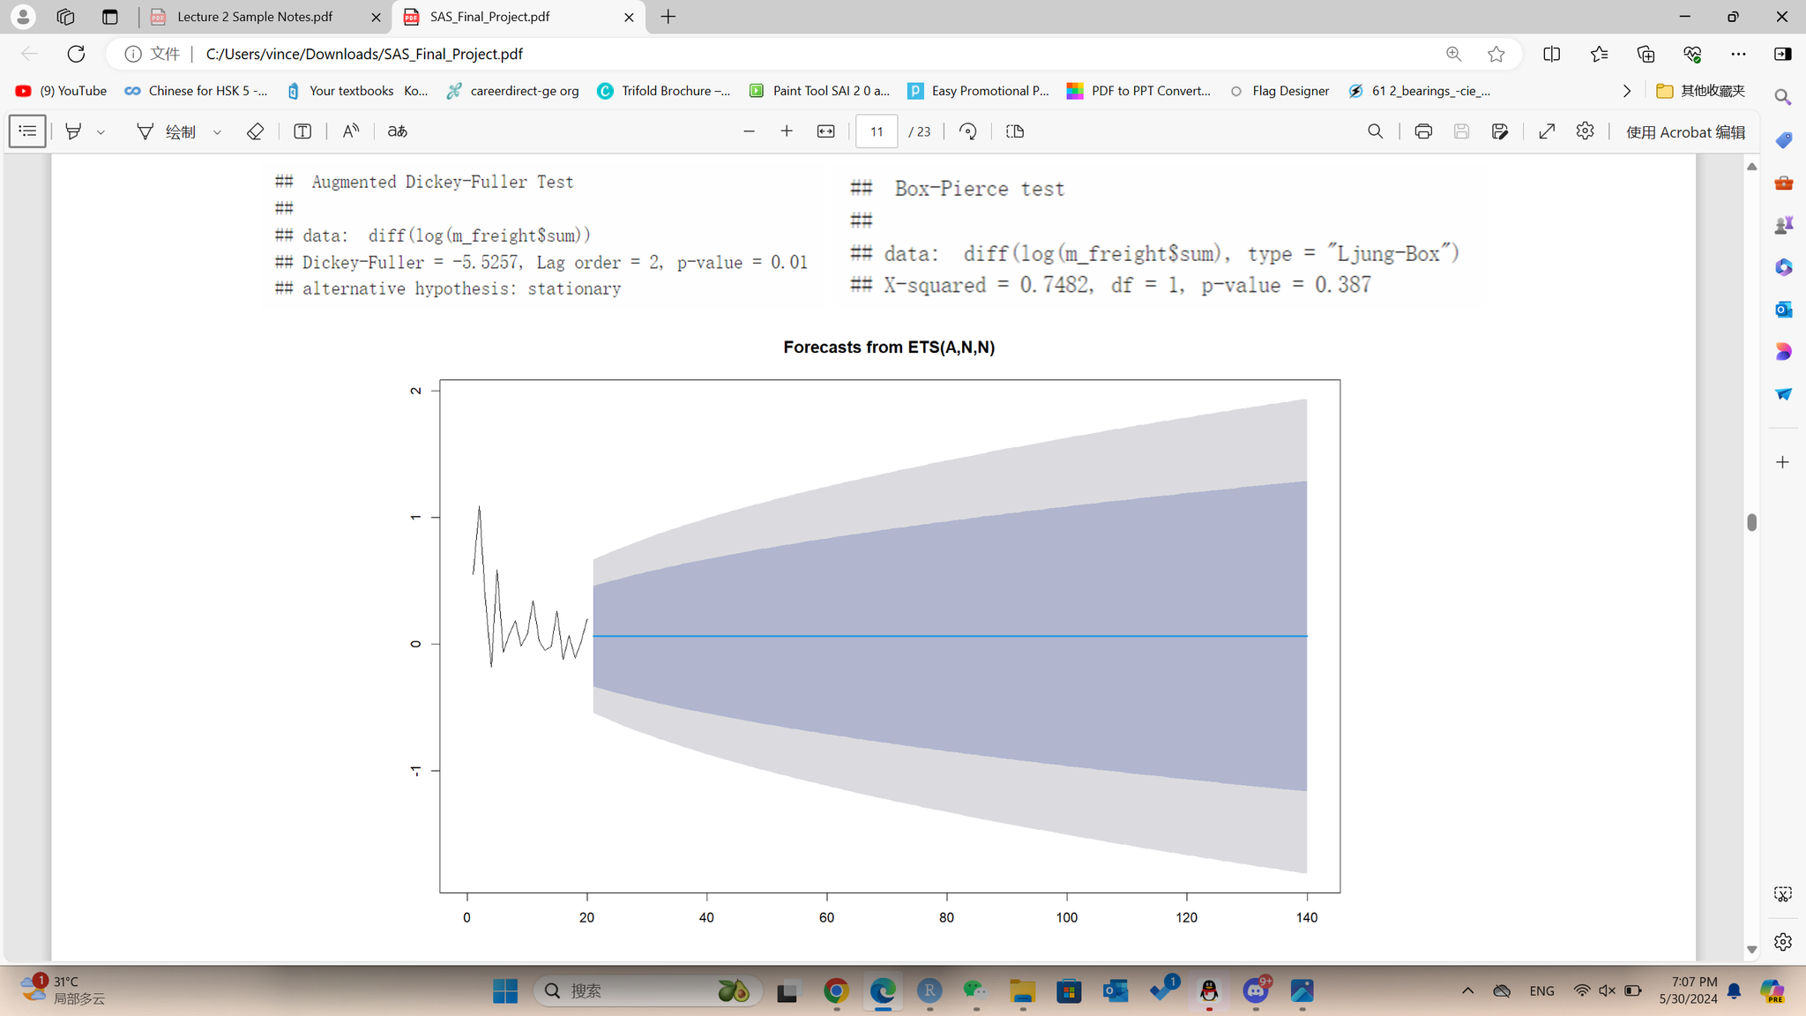
the differences of the logarithms of monthly freight value

Slide 23
Product Analysis
This section is dedicated to an investigation of the product's characteristics with the aim of identifying the user's preferences in the selection of the product.
Yanyu Liu

Slide 24
Product Analysis
Data Processing
Price Distribution
Relationship between Price and Freight Value
Sales volume
Product Score
Shipping Limit Date

Slide 25


Data Preprocessing

Slide 26
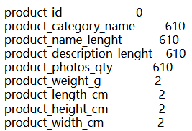
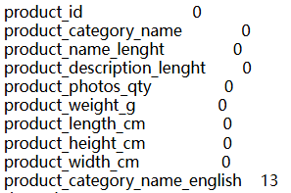
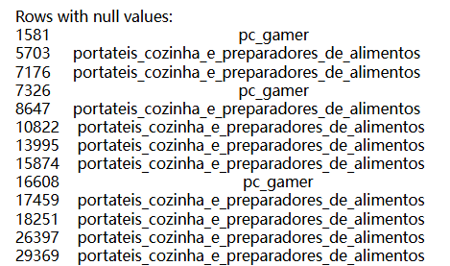
Data Preprocessing
delete missing value
translate category name
computer gamer
kitchen stand and food prep

Slide 27
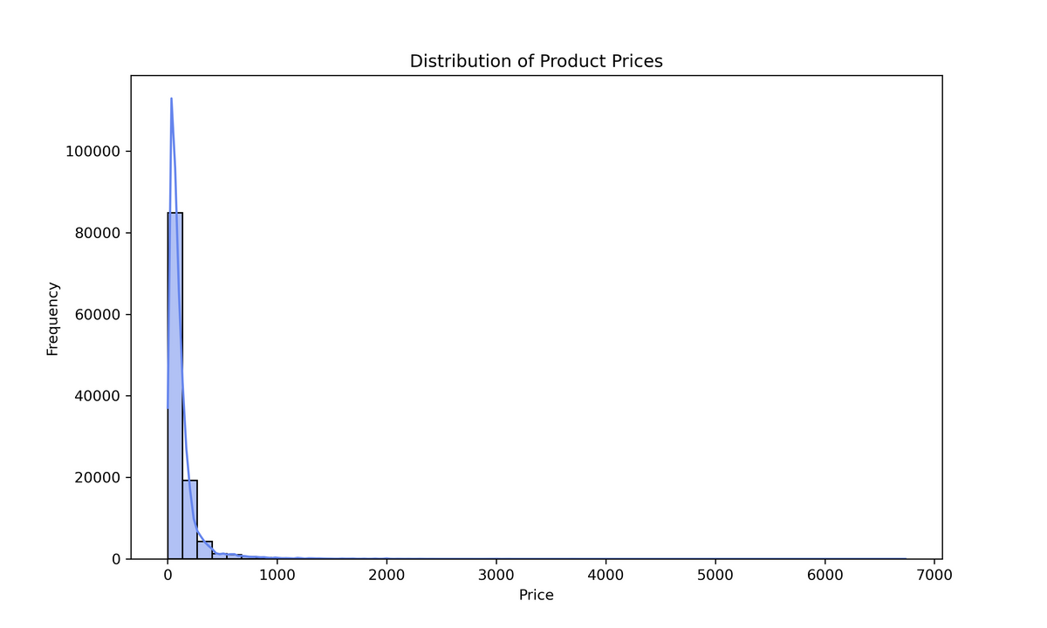
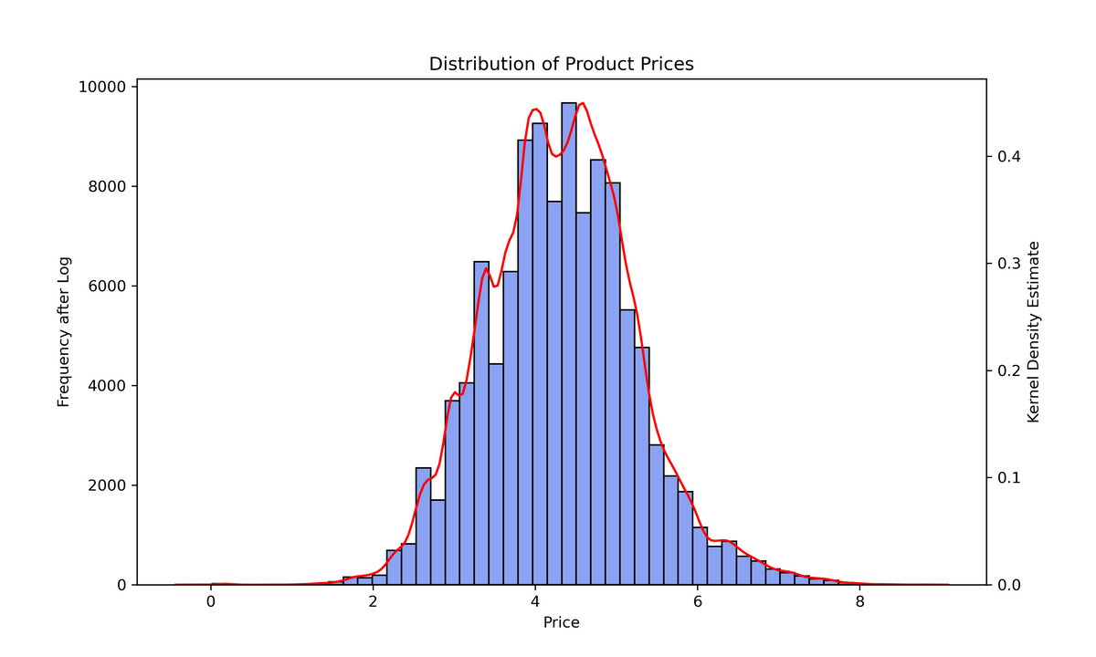
Price Distribution

Slide 28
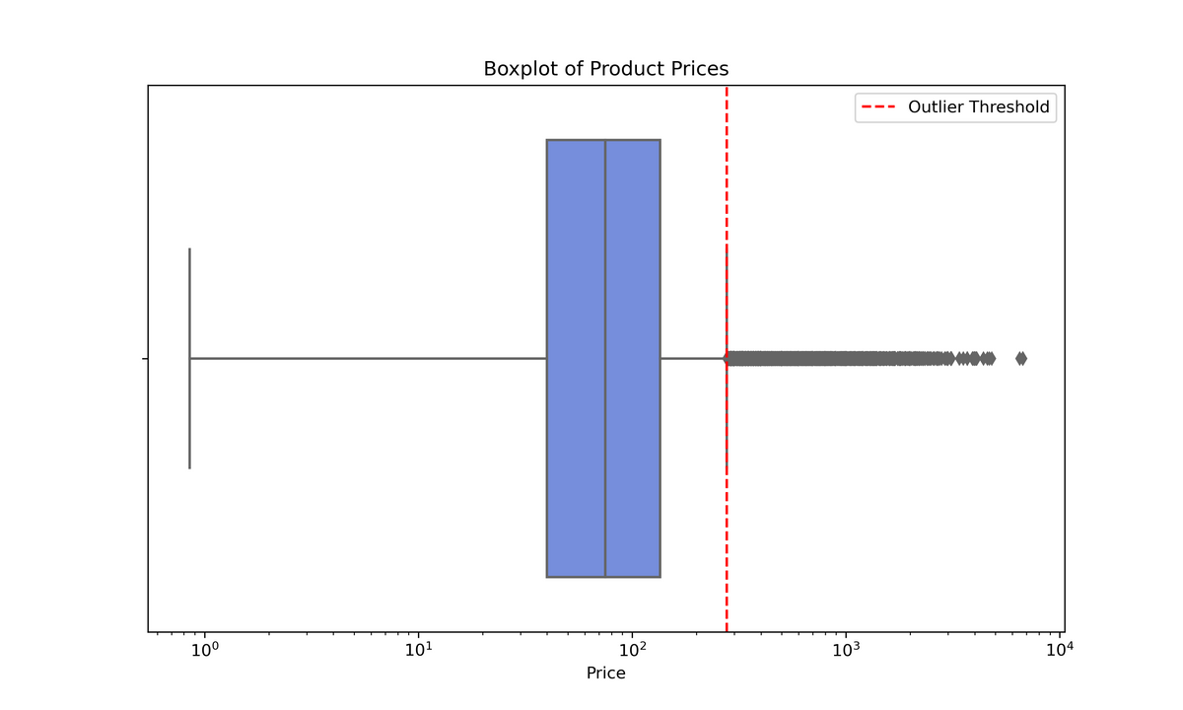
Price Distribution
25% Quartile: 39.9
Median: 74.99
75% Quartile: 134.9
Outlier Threshold: 277.4

Slide 29
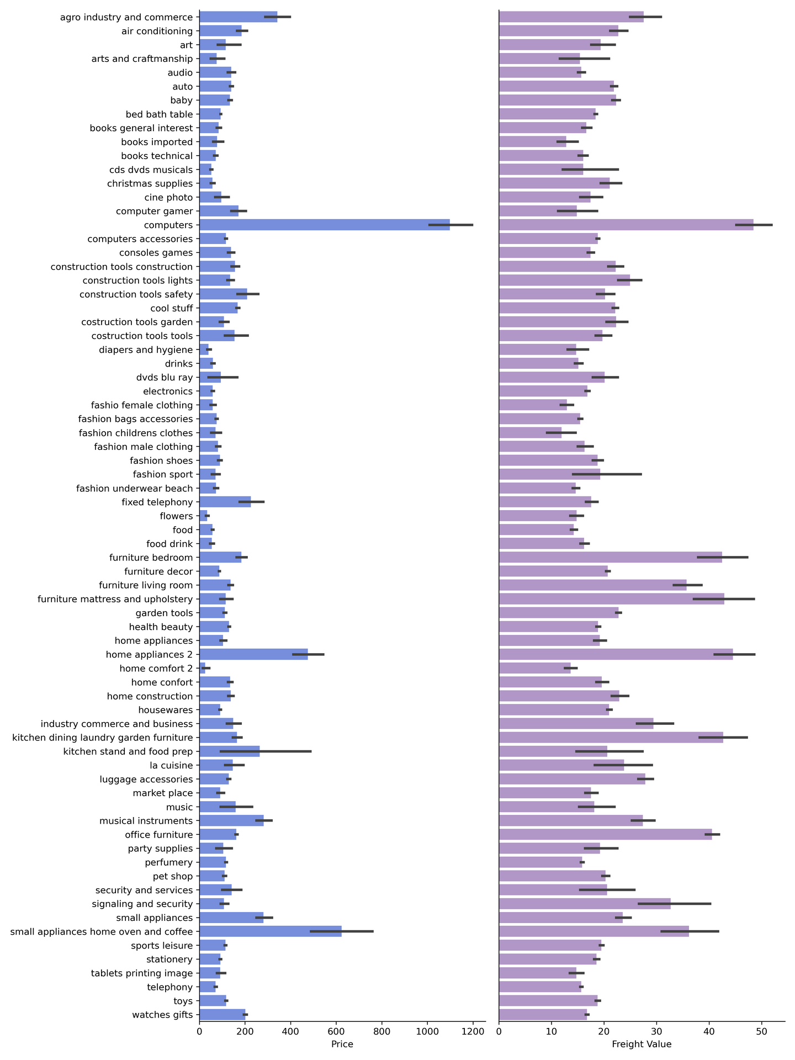
Relationship between Price and Freight Value

Slide 30
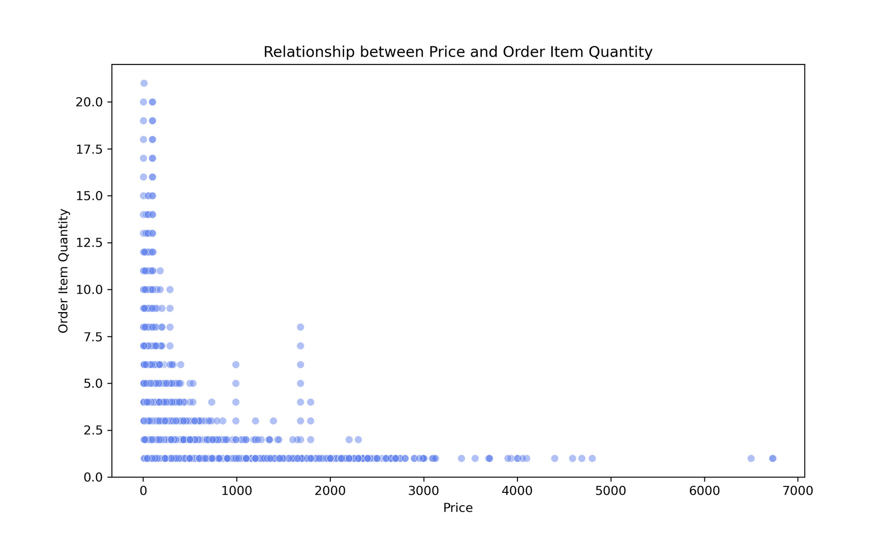
Sales volume

Slide 31
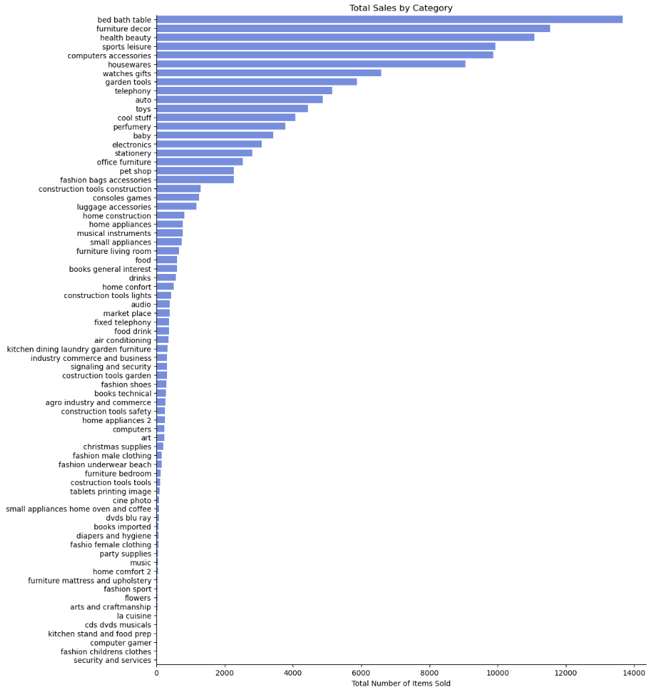
Sales volume

Slide 32
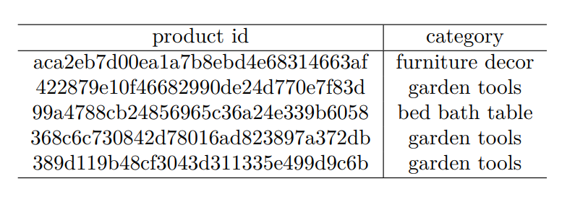
Product Score

Slide 33

Shipping Limit Date
order purchase timestamp - order delivered customer date
avg: 12.98
delivery days
Top 50
All Within Limits
order delivered carrier date - shipping limit date
All Early
whether the products are dispatched within the specified time
avg: 14.36
Bottom 50
6 Limit Crossed
order estimated delivery date - order delivered customer date
5 Late
Whether the product is delivered in advance

Slide 34
Association Rules Mining
Data Processing
Create Frequency Pattern Tree
Collaborative Filtering recommendation

Slide 35
Create Frequency Pattern Tree
Based on fp-growth algorithm
In this section, we explore the application of association rule mining to analyze transaction information from the dataset.

Slide 36
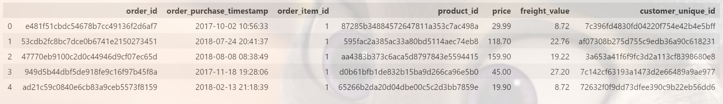
olist_orders_dataset
olist_order_items_dataset
customer_id
customer_orders

Slide 37
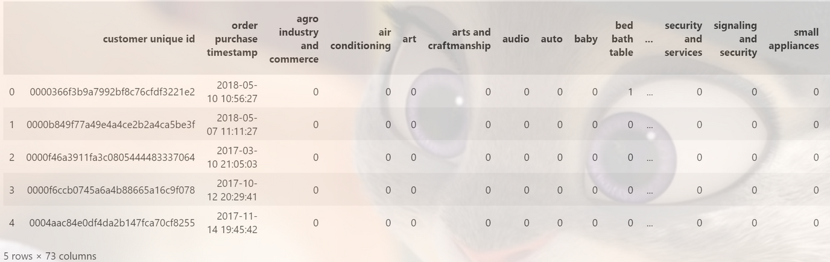
Transation Data
Next step, group by 'customer unique id' and summing all orders. Then converted to bianry columns since the actual quantity is not important.

Slide 38
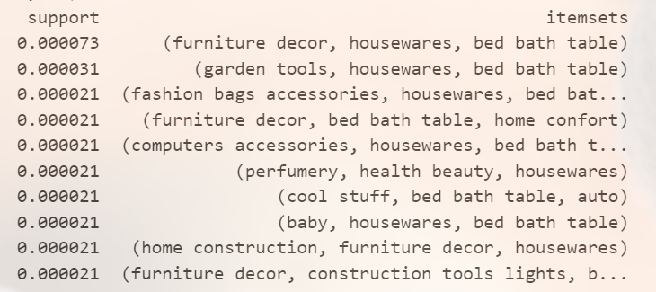
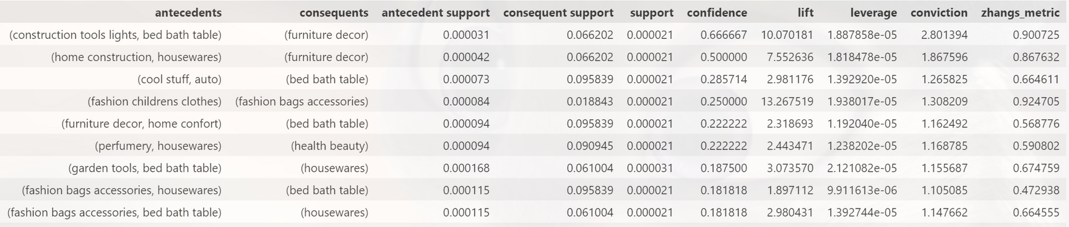
Itemsets and corresponding support
The results of Association Rules

Slide 39
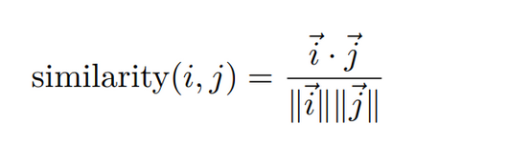
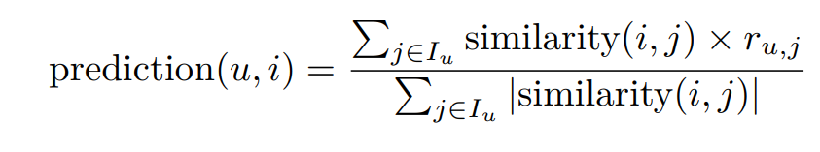
Collaborative Filtering recommendation
Cosine Similarity
Prediction Score

Slide 40
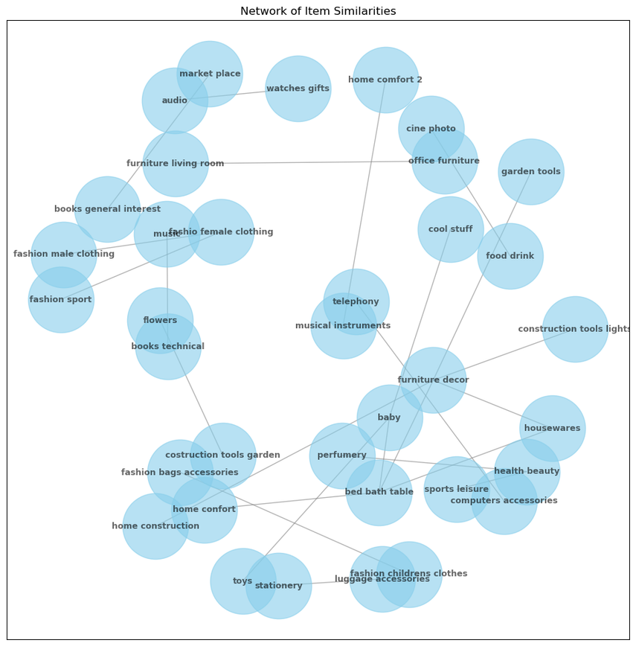
Visualization of Similarities

Slide 41
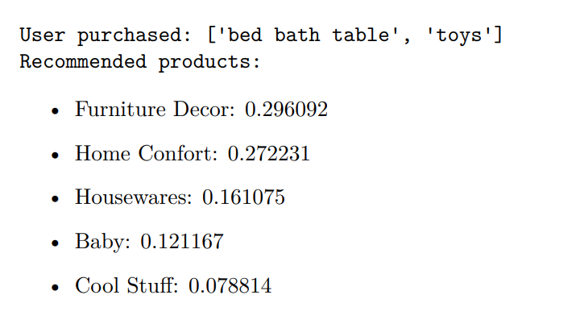
An Example

Slide 42
目前演讲人：PinZhao Li
Reviews Sentiment Analysis
Based on Unsupervised and Supervised method

Slide 43
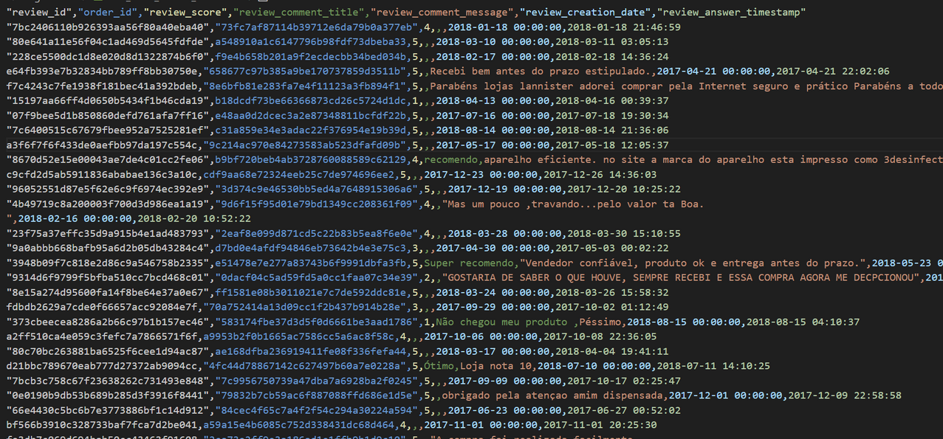
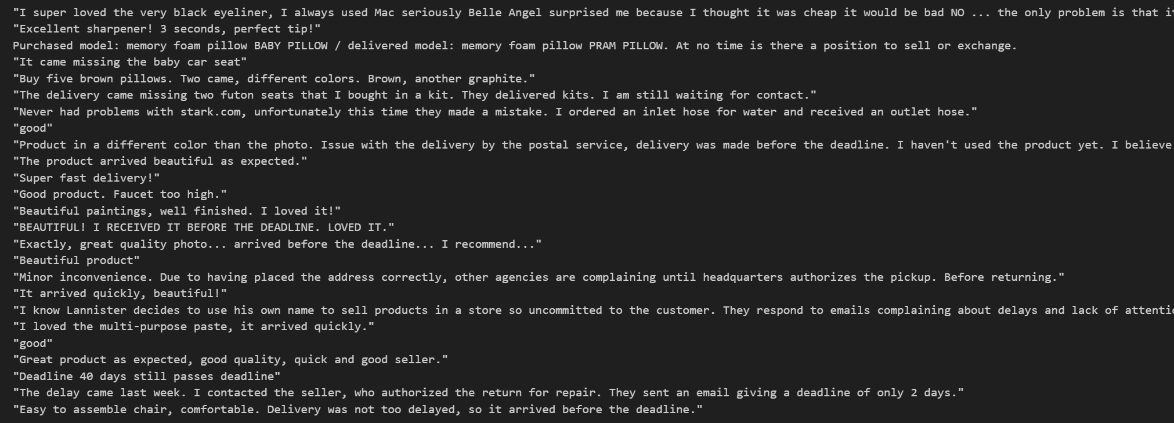
目前演讲人：PinZhao Li
AFINN and Textblob ---Wordlist-based approach for sentiment analysis.
Unsupervised learning can be performed to estimate the sentiments of these reviews and hence the popularity of a product. For unsupervised, the reviews have to be translated to English.
gpt-3.5-turbo translation
About 27500 data points were translated. Out of which 10K reivews are valid ones (not NaN).

Slide 44
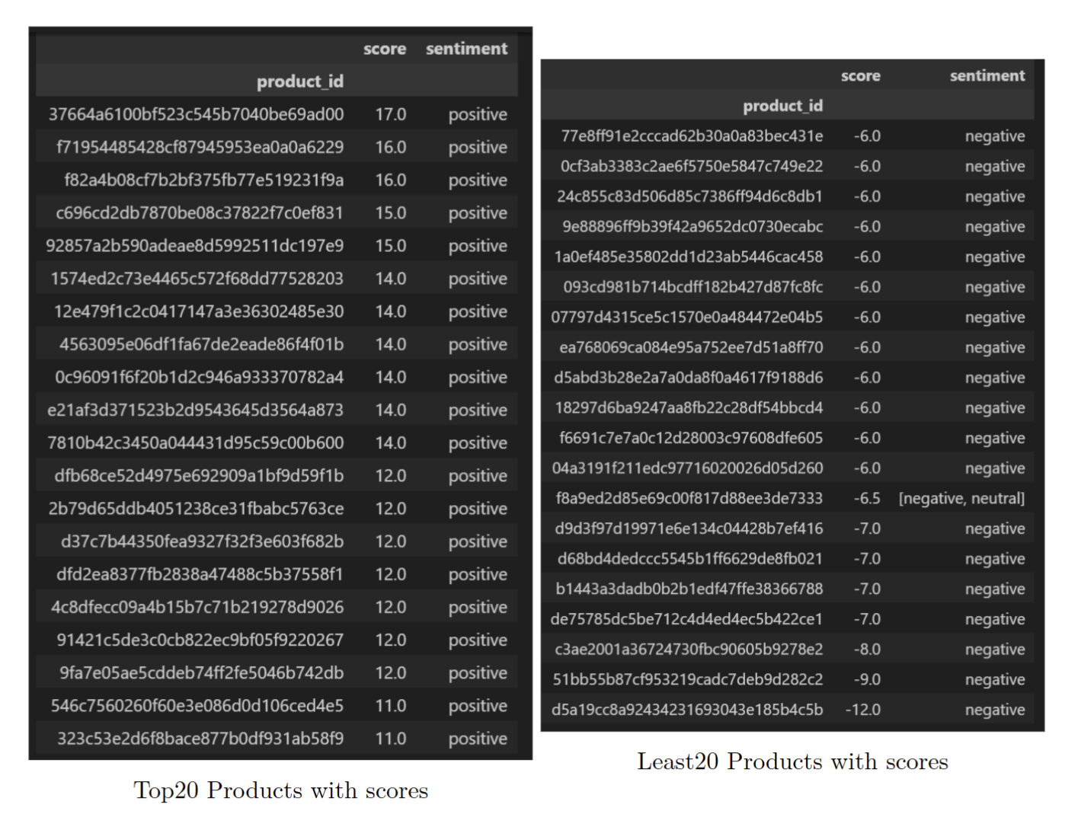
目前演讲人：PinZhao Li
AFINN and Textblob result:

Slide 45
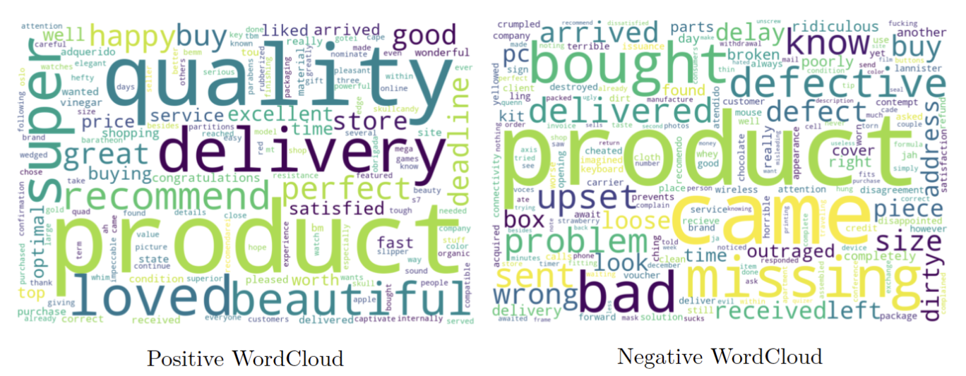
目前演讲人：PinZhao Li
AFINN and Textblob result:

Slide 46
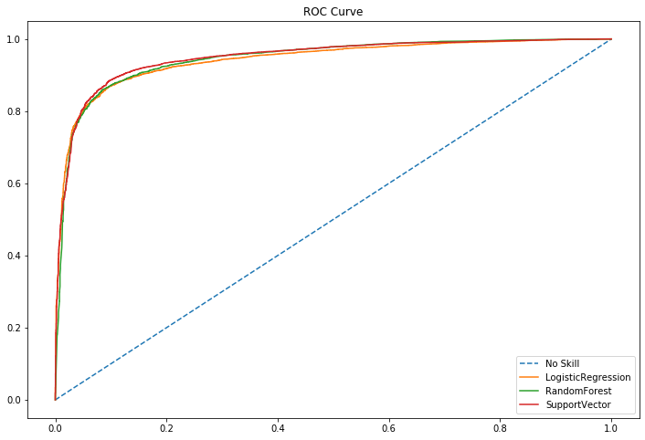
目前演讲人：PinZhao Li
Supervised Learning Model and Selection
Tfidf Metric
Give weightage to each word in the review
AUC LogisticRegression: 0.942435674180289
AUC RandomForest: 0.9450056715387773
AUC SupportVector: 0.9485774753873948

Slide 47
Thank you!

